Slide 1
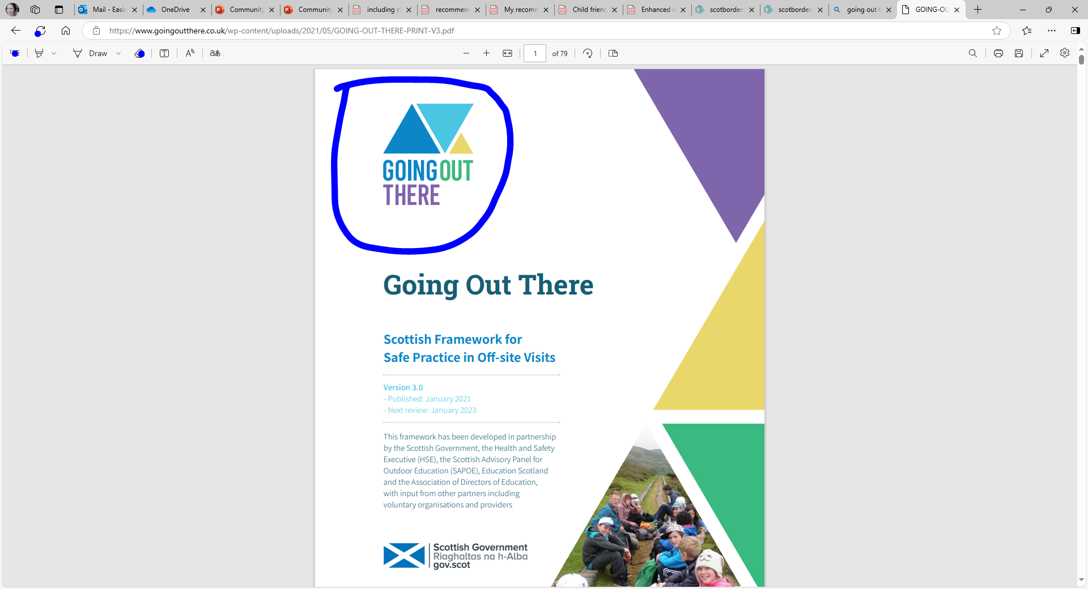
Let’s Plan a trip together! – Primary Template

Slide 2

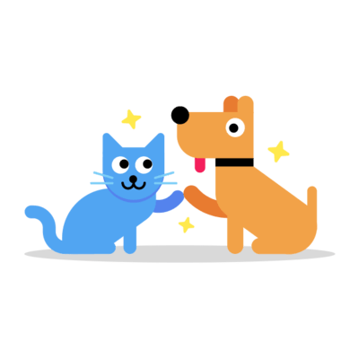
Planning a trip can be fun and exciting, and your ideas are important! Here’s how you can help make it the best trip ever!
Get
Involved!
Notes:
Remember to think about how everyone can be included in the trip and the planning, some people will have different needs than you, what might they be?

Slide 3

Where can we go?
Option 1
Give 3 places to choose from
Option 2
Gather ideas from students
Option 3
Have somewhere identified but give choice in the itinerary for the day.
For example – Museum of Natural History, list 3 areas in order of importance you would like to visit – go with top choices.
Notes:
Example Trip: Learning About Our Local Wildlife
Children and young people were learning about local wildlife and their habitats. They decided they wanted to visit a nearby nature reserve to see animals in their natural environment and learn more about conservation efforts.

Slide 4

Step 1: Gathering Ideas
Collaborative & Visual Methods
Mind Map – Pupils visually brainstorm ideas on a large sheet or digital tool.
Post-it Note Collection – Pupils write ideas on sticky notes and place them on a board.
Graffiti Wall – A large sheet where pupils freely write/draw thoughts.
Draw & Explain – Pupils illustrate their ideas and present them.
Word Association Web – Start with a key theme and branch out related words/ideas.
Notes:
To get everyone’s input, the teacher:
Held a brainstorming session where children shared ideas for places to visit.
Used a suggestion box for those who preferred to write their ideas down.
Created a quick survey to vote on the most popular destination.
The nature reserve was chosen because it matched what the class was learning and had lots of exciting activities like pond dipping and a guided wildlife walk.

Slide 5

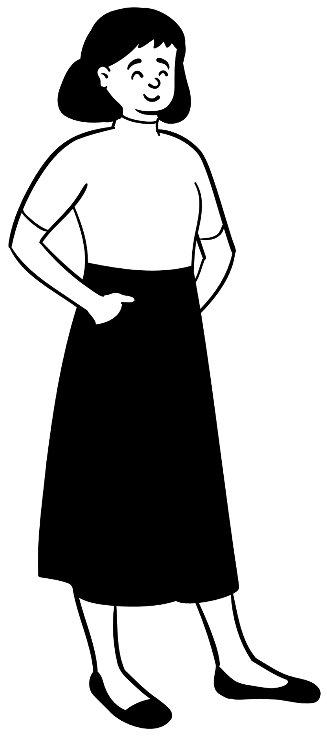
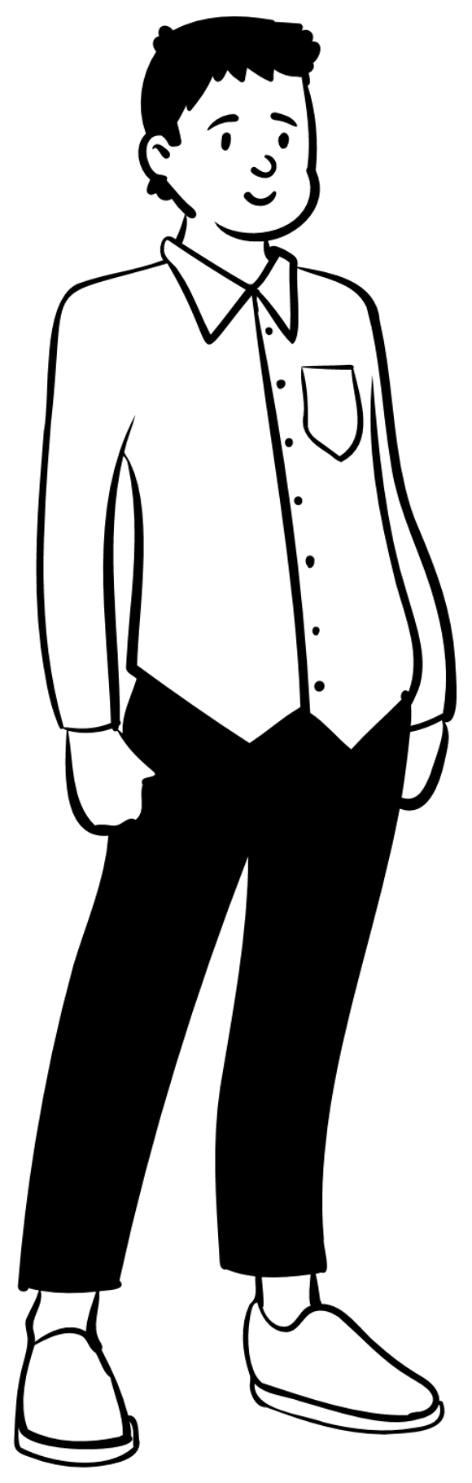











Step 2: Planning the Trip with the Framework
How many adults will we need to help us?
How will we get there?
What hazards might be there?
Who do we all need to tell and how?
Before we plan a trip, we need to think about ….
Who will help us if we get hurt?
Notes:
Using the "Going Out There" framework, the teacher:
Completed a risk assessment for the nature reserve, considering hazards like uneven paths and proximity to water.
Ensured appropriate supervision ratios and briefed adult helpers.
Arranged transport, confirmed first-aid provision, and planned an emergency procedure.
Communicated with the nature reserve staff to tailor activities for the group.

Slide 6
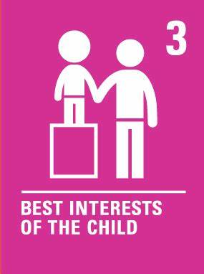






Step 3: Creating a respectful relationships contract.
How will we move?
What will we do with our rubbish?
What about technology?
What if we have questions or a problem?
How will we sound?
Who will we be with?
Notes:
he class worked together to design a respectful relationships contract. Here’s what they agreed:
Wildlife Visit Respectful Relationships Contract
Be quiet and respectful around animals to avoid scaring them.
Stay with your group and always use the walking partner system.
Follow the guide’s instructions and ask questions politely.
Keep the area clean by using bins for any litter.

Slide 7




What skills will we be practising?
Create a table to check off
Meta-skill | How I used it | Stamp/Tick/ Colour
Planning & Organising | I helped make the trip checklist
Teamwork | I worked with my group to stay safe
Communication | I asked questions and shared ideas
Problem-Solving | I helped decide what to do if...

Slide 8
Evaluating the trip
Let's think of some questions for after the trip, to help us think about how well the trip went.
Notes:
What did you enjoy most about the trip?
What did you learn about wildlife?
Was there anything you’d do differently next time?
Which skills did you improve during the trip? (Circle all that apply)
Planning | Teamwork | Communication | Responsibility | Problem-Solving
Any other comments?

Slide 9

Your Voice Matters!
Notes:
When you help plan a trip, it’s more fun and works better for everyone. Talk to your teachers or group leaders about your ideas and make this trip amazing for all of us!

