Slide 1
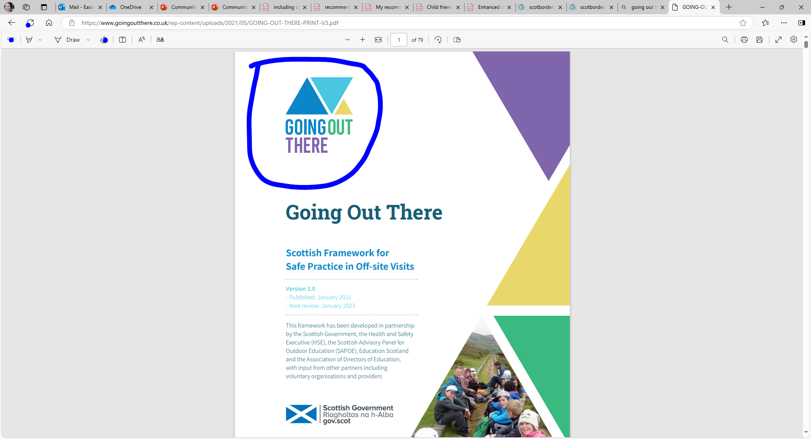
Let’s Plan a trip together! – Primary Template

Slide 2


Planning a trip is an exciting chance to make unforgettable memories, and your input matters! Here’s how you can help make it the best trip ever:
Get Involved!
Notes:
Remember to think about how everyone can be included in the trip and the planning, some people will have different needs than you, what might they be?

Slide 3

Where can we go?
Option 1
Give 3 places to choose from
Option 2
Gather ideas from students
Option 3
Have somewhere identified but give choice in the itinerary for the day.
For example – Museum of Natural History, list 3 areas in order of importance you would like to visit – go with top choices.
Notes:
Example Trip: Exploring Careers in Science and Technology
Older students were learning about careers in science, technology, engineering, and mathematics (STEM). They decided they wanted to visit a university research lab and a technology company to explore career opportunities and see how STEM is applied in the real world.

Slide 4

Step 1: Gathering Ideas
Collaborative & Visual Methods
Mind Map – Pupils visually brainstorm ideas on a large sheet or digital tool.
Post-it Note Collection – Pupils write ideas on sticky notes and place them on a board.
Graffiti Wall – A large sheet where pupils freely write/draw thoughts.
Draw & Explain – Pupils illustrate their ideas and present them.
Word Association Web – Start with a key theme and branch out related words/ideas.
Notes:
Step 1: Gathering Ideas
To get everyone’s input, the teacher:
Held a class discussion where students shared ideas for industries and companies to visit.
Used an online poll for students to vote on their preferred destinations.
Asked students to research and suggest companies or universities that offer educational visits.
The university research lab and tech company were chosen because they aligned with student interests and offered hands-on activities, career talks, and networking opportunities with professionals.

Slide 5



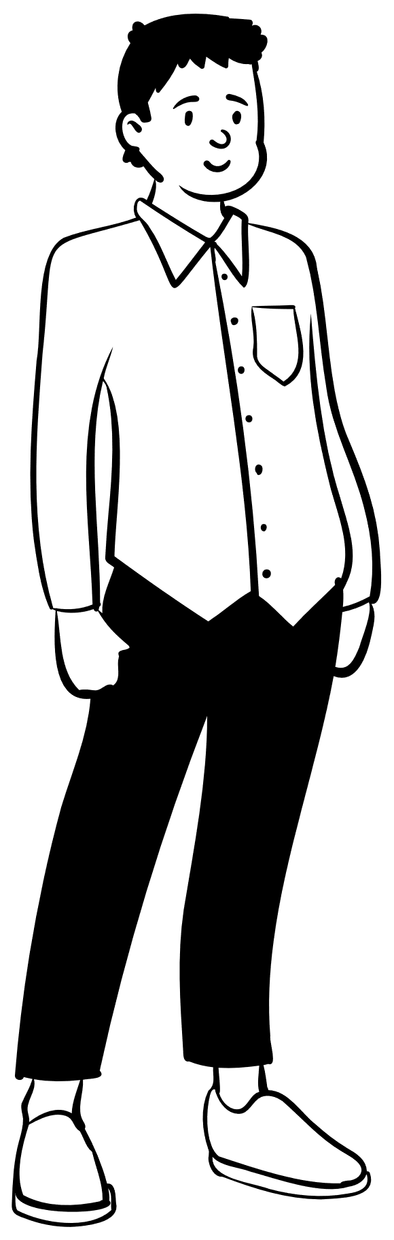










Step 2: Planning the Trip with the Framework
How many adults will we need to join us?
How will we get there?
What hazards might be there?
What safety equipment might we need to wear?
Do we need first aider?
Before we plan a trip, we need to think about ….
What checks / paperwork/ permissions are needed?
Is it accessible for all students? Do we need to make any amendments?
Notes:
Step 2: Planning the Trip with the Framework
Using the "Going Out There" framework, the teacher:
Conducted a risk assessment, considering transport, safety within the lab, and group supervision.
Arranged for guest speakers and practical demonstrations at both venues.
Planned logistics such as transport, schedules, and permission forms.
Ensured accessibility for all students and briefed them on expected professional conduct.

Slide 6







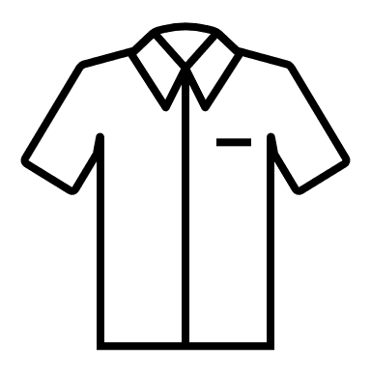



Step 3: Creating a respectful conduct agreement.
Consider the appropriate clothing for setting.
Arrive on time and ensure you have brought everything with you.
Follow any safety guidance.
Represent your school responsibly?
What about technology?
Consider questions prior to the trip?
Notes:
Step 3: Creating a Respectful Conduct Agreement
The students collaborated to design a respectful conduct agreement. Here’s what they agreed:
STEM Visit Conduct Agreement
Arrive on time and dress appropriately for a professional setting.
Be respectful to professionals and ask insightful questions.
Follow safety rules in the lab and tech company environments.
Represent our school positively and behave responsibly.
Engage actively in discussions and hands-on activities.
Everyone signed the agreement to show their commitment.

Slide 7
What skills will we be practising?
Create a table to check off
Meta-skill | Examples of How I used it | Reflection & Further comments
Critical Thinking | Asked thoughtful questions & analysed data.
Networking | Introduced myself and engaged with professionals.
Time Management | Followed the schedule and managed my time well.
Problem-Solving | Adapted to challenges and found solutions.

Slide 8

Evaluating the trip
Let's think of some questions for after the trip, to help us reflect on the trip, learning, skills development and future recommendations.
Notes:
Students can complete the last column to reflect on how they applied these skills, and any personal insights gained from the trip.

Slide 9

Your Voice Matters!
Your voices help shape these experiences, and that matters. The ability to plan, collaborate, and advocate for what’s important to you are skills that will take you far beyond this trip. Never underestimate the impact of your voice, not just here, but in every space, you step into.

